Slide 1
Living with The 3 Key Financial Statements
Putting the pieces together
By Adrian Payne

Slide 2
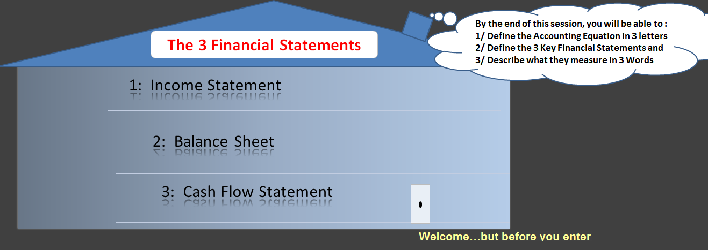
Notes:
Interest : Grab learner’s attention. Relevant to the home [ WIIFM ]
There’s something for all my guests inside, whether you’ve worked in Finance before or you don’t have the foggiest idea of what a Debit or a Credit is, it doesn’t matter. There’s something for everyone here. Everyone is welcome because everyone knows what money is.
By the end of this session you’ll be able to identify the three (3) key financial statements and describe in 3 words what each measure. My guests will also be able to define the Accounting Equation.

Slide 3
Identify the Visitors
  Who currently works, or has ever worked in Finance?
    Who knows what the Accounting Equation is?
      Who knows what money is?
      Who knows what cash is?
        Is there a difference money and cash?
        Anyone heard of the phrase Asset Rich but Cash Poor?
Notes:
Need: To check learner needs. How much existing knowledge, if any, do the learners have
If we have time, I’d like to open the floor up for a discussion on the distinction between money and cash

Slide 4
Agenda
Living with The 3 Key Financial Statements
Income Statement
Balance Sheet
Cash Flow Statement
Introduction
Balance Sheet:
Two sides to a story
The Accounting Equation
Domestic Accounting Exercise
Income Statement Example
Cash Flow and The Plasma TV
Fundamental Concept: Timing
Conclusion
Notes:
The Income Statement is also known as the Profit and Loss Statement. These names are used interchangeably by both the public and the professionals.
Whether you realise it or not, these guys are living under your own very roof. You might as well get to know them.

Slide 5
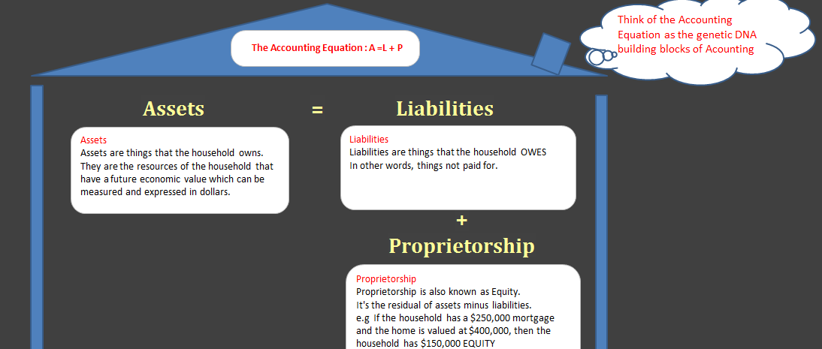
Notes:
Assets = Liabilities + Proprietorship
Another way of expressing the Accounting Equation is:
Proprietorship = Assets – Liabilities
Example
Your home is worth $400,000 and you have $250,000 left to pay on your mortgage.
How much Equity do you have?
Using Equation 1 : A = L+P Using Equation 2 : P = A – L
400,000 =250,000 + ? ? = 400,000 – 250,000
If you answered $150,000 in both you’re correct.

Slide 6
Income Statement
Income Statement : Month Ending April 30th 2011 | Dollars AUD | Margin % of Sales
Sales Revenue | 5,000
Less Cost of Goods Sold | 0
Gross Profit | 5,000
Rent Make-up and Cosmetics Kids School Fees AGL Power Petrol Groceries Tram Tickets | 1,500 150 400 100 150 100 400 50
Total Expenses | 2,850
Net Income | 2,150 | 43%
Notes:
Here is an example of an Income Statement for a Household.
** It’s really called the Income and Expense Statement or the Profit and Loss Statement in formal reports
The details are unimportant. *** Ignore the Cost of Goods Sold.
Cost of Goods Sold represents all the costs associated with making and selling a product. The Domestic Household typically won’t have any
(they could, but let’s not get hung up on this for now)
But what is important is the Structure and what the Income Statement tells the householders
Revenue
The Domestic Accounting householders earn their income as Wage Earners. This was paid in the same month as it was earned.
Less Expenses
We apply the same logic to the Expenses paid. That is, the householders paid the expenses in the same month they incurred the expense.
=Net Income
If what’s left over is a positive number, then it’s a Profit.
If what’s left over is a negative number, then it’s a Loss.
That’s why this Statement is also known as the Profit and Loss Report.

Slide 7
Fundamental Concept
The Timing of Events
Income statement
CASH flow statement
The Income Statement records when the event happened NOT when the payment happened.
Because the income statement is prepared under the accrual basis of accounting, the revenues reported may not have been collected. Similarly, the expenses reported on the income statement might not have been paid.
Records actual cash receipts and cash payments.
Notes:
The householders who reside at No 1 PowerPoint Slide, Learning Land are both wage earners and get paid every Friday for the hours worked in that week.
Refer to the Revenue section of the Income Statement in Slide 6 when considering what I’m about to say next.
If a new month begins during the week, say, on a Wednesday, then the householders would each receive 2 pay packets that week.
-> There would be 1 Pay Packet for Monday and Tuesday [Paid on Tuesday night]
and another Pay Packet for Wednesday to Friday [Paid on Friday as per usual]
Question : Does anybody know why I’ve made this distinction?
Answer : Because now the Income Statement is the Cash Flow Statement.
[Assuming of course that the payment of expenses is handled in the same manner]
The Cash Flow Statement is used as a tool to convert the Accrual method of Accounting into a Cash based method of record keeping.
Don’t worry about the Accrual jargon introduced here. For the purposes of this exercise, there are no timing issues to consider, therefore the Income Statement is the Cash Flow Statement.

Slide 8
Balance Sheet
Remember the Accounting Equation : A= L + P
Think of the Balance Sheet as a piece of paper with a line drawn down the middle of the page
ASSETS
Assets on the left side
LIABILITIES
Liabilities on the right side
PROPRIETORSHIP
Proprietorship on the right side
Notes:
We don’t have time to discuss the Balance Sheet in any real detail today. It measures wealth or lack thereof and for this session, that’s really all you need to know.
The Domestic Accounting Exercise referred to in the next slide has a bonus question on the Balance Sheet but don’t get pre-occupied with it.

Slide 9
Domestic Accounting : Homework
It doesn’t have to be a chore
Please refer to the two page Word Document :
There are two questions:
Time permits us only to work through the first question in class.
-> Remember that the *Accrual method of Accounting records Income and Expenses when they’re incurred, not when they’re paid.
- > The Cash method records only when the receipts of payments are made.
The second question is a bonus.
To be completed outside of class
If you need help, please email me or call
*see Slide 7 for an Accrual recap
Notes:
Refer to the handout : Joey and his Double Click business

Slide 10

Cash Flow Statement
Practical thinking
For example, when you use cash to buy a Plasma TV,
you own the TV (you've increased your "assets") but you also have less money (you've decreased your cash in the bank)
Cash can come from three different sources
Operating Activities → Normal business activities
Investing Activities → Sale of Assets e.g. Plasma TV
Financing activities → Share issues or ask your parents
Notes:
For the purposes of our discussion, and if you refer back to slide 7, the Income Statement was the Cash Flow Statement.

Slide 11
Conclusion
Profit is the money left over at the end of the month after all household expenses have been paid.
The Profits increase household wealth which is recorded on the Balance Sheet. You may decide to leave the cash in the bank or make an additional mortgage payment or you may buy a Plasma television.
This is the cash flow. No point paying off bank debt or buying gadgets for the home if you don’t have the cash to buy groceries and the daily essentials.
Profit
Health
Wealth
Managing household finances effectively can be a bit of a juggling act to find the optimum mix of each.
A = L + P
Notes:
Income Statement measures your Profitability → The Profit gets transferred to the Balance Sheet (whether you realise it or not)
E.g. Business is booming and you decide to buy another house with all your profits. This is an Asset and is recorded on the Balance Sheet.
Balance Sheet measures your Wealth → The more houses you buy, the greater your wealth.
Now you should be able to see the relationship between the Income Statement and the Balance Sheet.
Cash Flow Statement measures your Health → The ability to meet the everyday household living expenses like food and grocery bills, fuel and oil
No point owning two homes if you don’t have the available cash to meet the day to day costs of living. This is what it means to be Asset Rich but Cash Poor.

Slide 12

The 3 Key Financial Statements
Now you know their place in your home:
Income Statement : To measure PROFIT
Balance Sheet: To measure WEALTH
Cash Flow Statement: To measure HEALTH
Notes:
This concludes the Domestic Accounting session: Living with the 3 Financial Statements. Well done guys. Getting to know them well takes time but at least now you know the names of those living under the same roof as you.
For those looking to go beyond Domestic Accounting, the next learning session will be Small Business Accounting. In this session, learners will develop their knowledge of The 3 Key Financial statements as they relate to the commercial and strategic decisions of the business.
But if there are any questions about any of the content within this session, I’d be pleased to hear from you at :
Budge1970@hotmail.com
Thank you for your time. You’ve been a great audience.

